Slide 1
Intelligent DustBin-IdB
By:
Margarita Mollova, № 81957
And
Radostin Dimitrov, № 81952

Slide 2
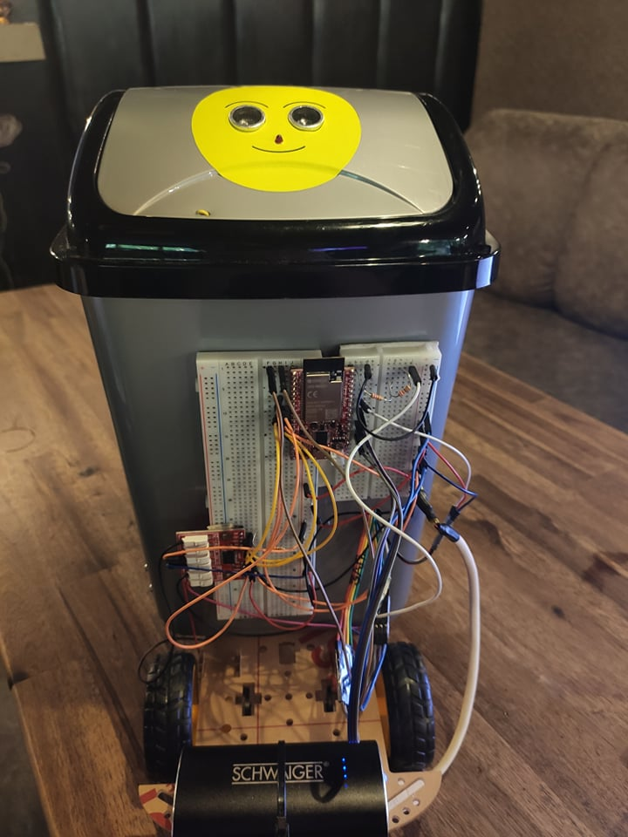
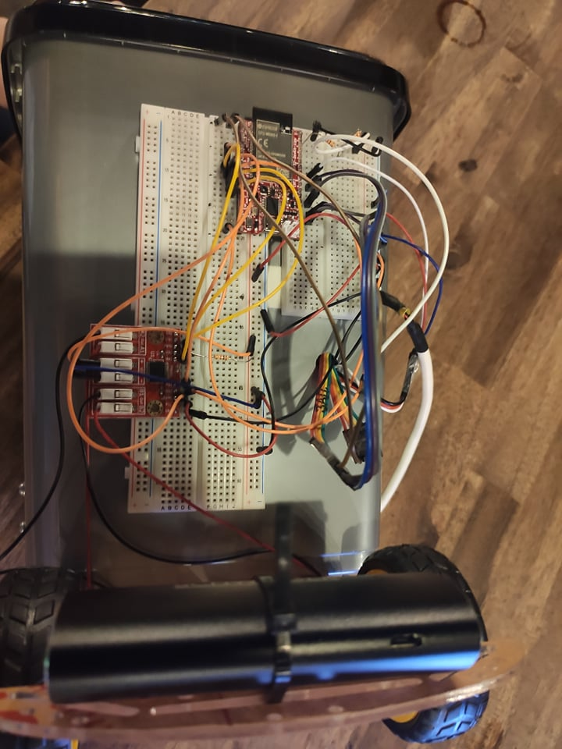

Slide 3
Components
ESP32-WROVER-DevKit-Lipo
ROBOT-2WDL-KIT
DUAL DC MOTOR DRIVER 12V 1.2A WITH PWM AND ROTATION DIRECTION
HC-SR04 Ultrasonic sensor x2
Servo Motor
Light-emitting diode(LED)
Power bank
Breadboard
Jumper Wires

Slide 4
Functionalities
Self-opening lid
Fulness awareness
Mobility

Slide 5
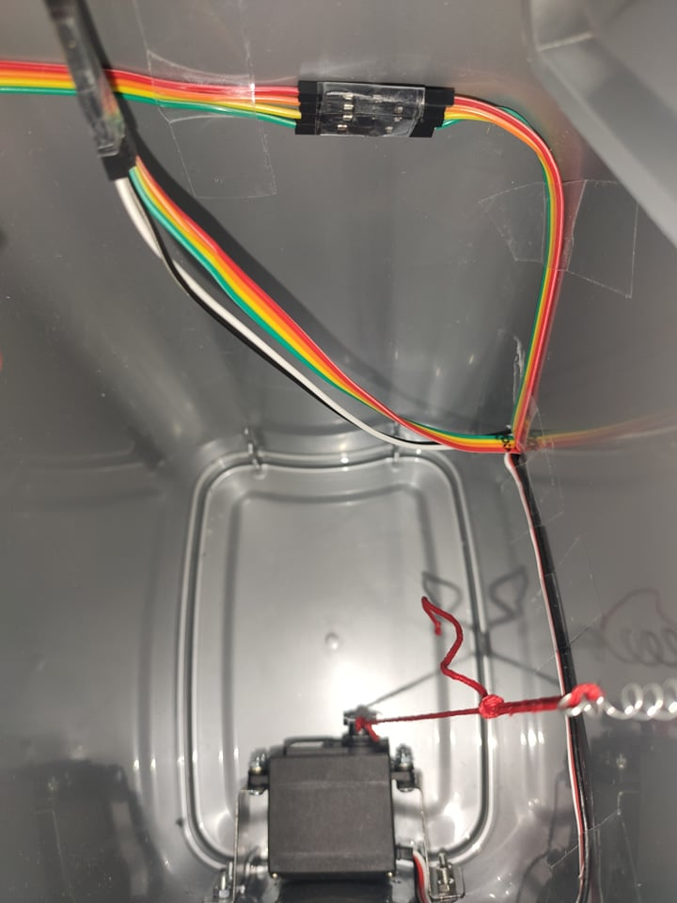
Self-opening lid - description
Upon detecting an object in less than 20cm, opens using a Servo motor inside.
The Servo motors pulls a thread, which is connected to the lid.
Upon opening, the lid stays open for 10sec and then closes.

Slide 6
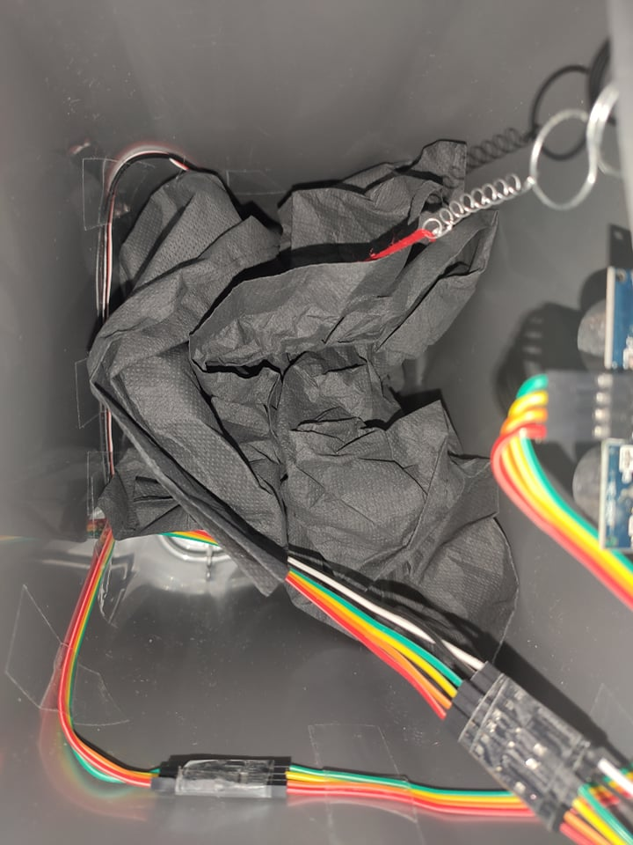
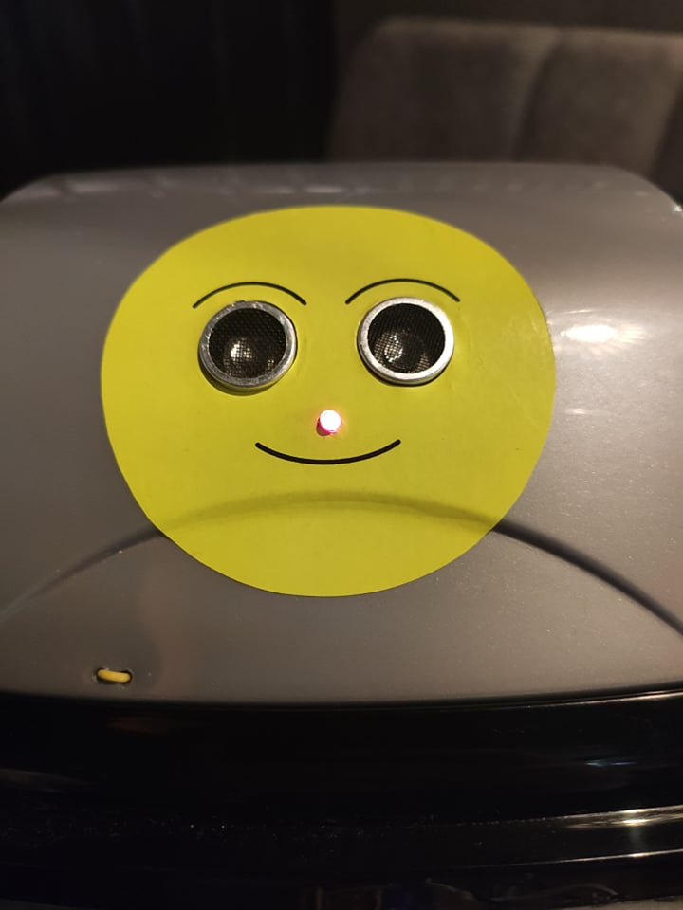
Fulness awareness - description
Upon detecting objects in the bin that are less than 7cm from the lid’s bottom part, a LED starts blinking, indicating that the bin is full.
It’s not possible to open the lid, when the bin is full. Meanwhile, the LED starts blinking more frequently.
When emptied, the LED stops blinking and throwing objects is possible again.

Slide 7
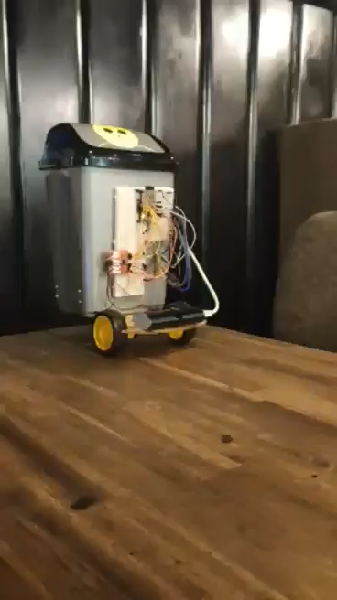
Mobility - description
Uses data from the phone’s accelerometer.
Based on it, moves in the direction the telephone is tilted.

Slide 8
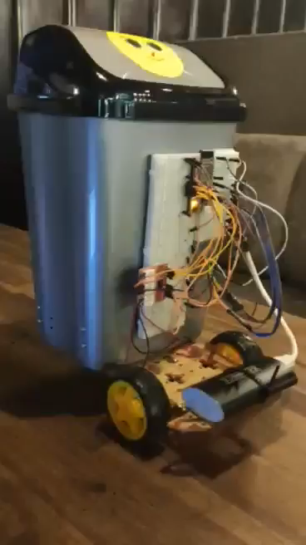
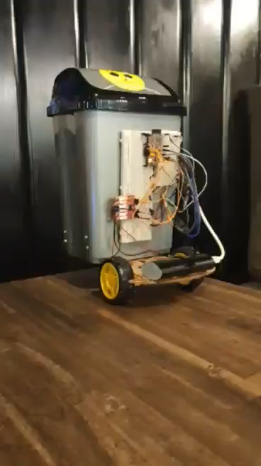
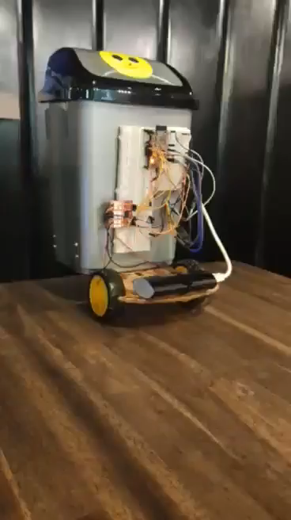
More demonstrations of mobility

